Slide 1


Slide 2


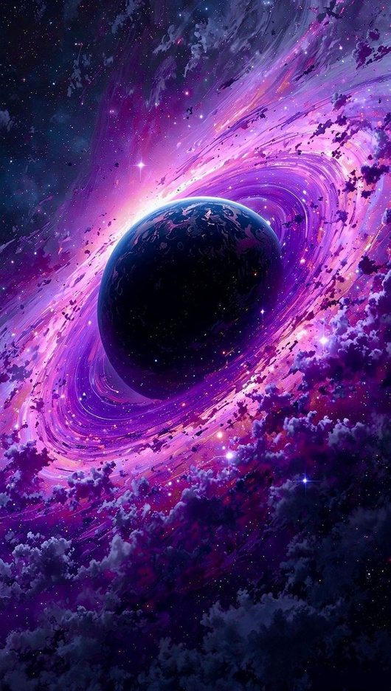
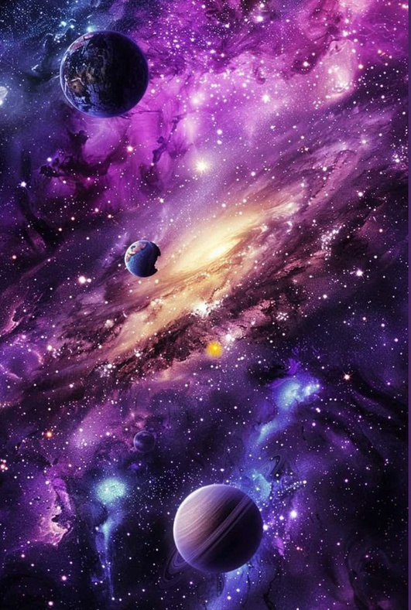
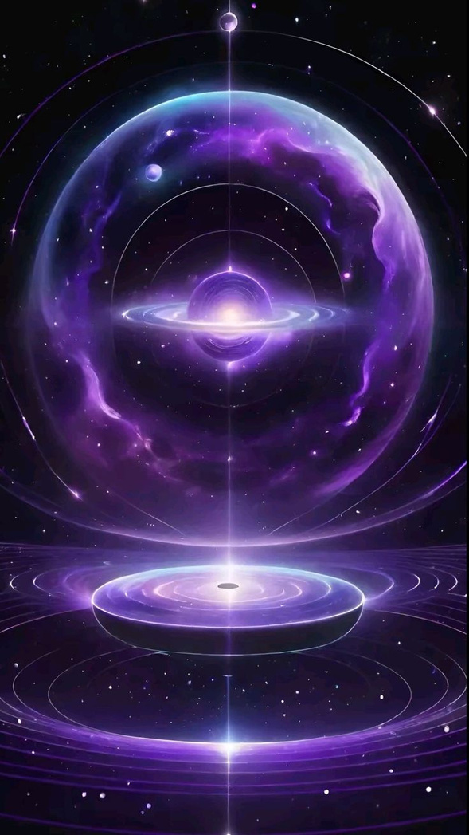
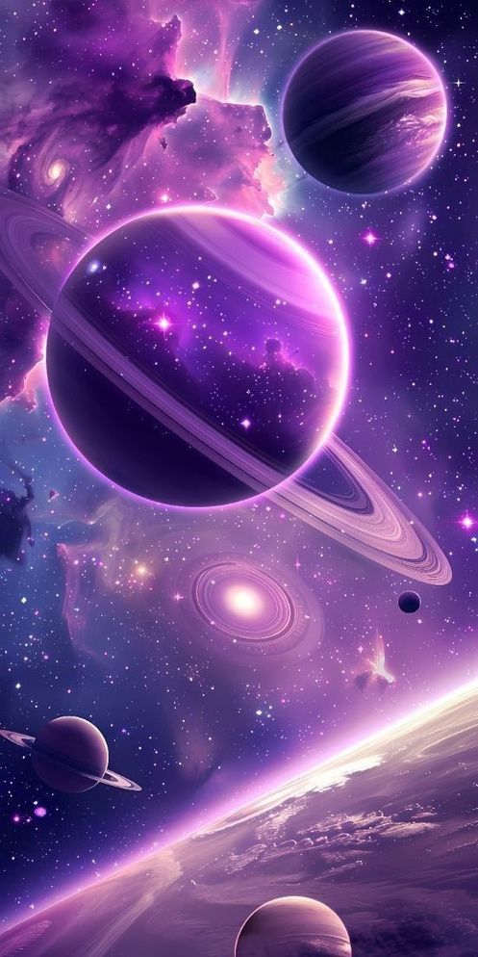

Traveler
By : Marwan shreef

Slide 3

3D Planetary Visualization
3D solar system Visualization
there is AI chatbot on the site
Interactive Exploration
Easy to use and smooth

Slide 4
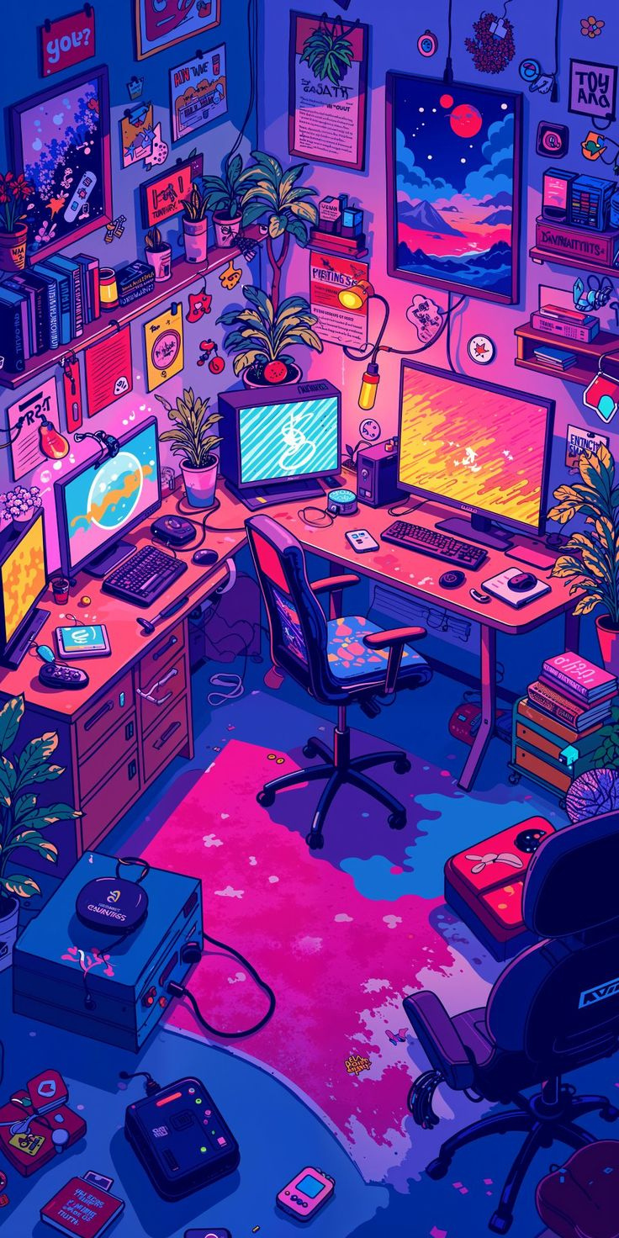
Target audience
Engineering students and students
Educators & Professors
Scientists & Researchers

Slide 5
Project benefits
01
02
03
Providing a different and first-of-its-kind experience around the world
Developing the imagination of space enthusiasts
Supports UN SDG 4 : Quality Education

Slide 6
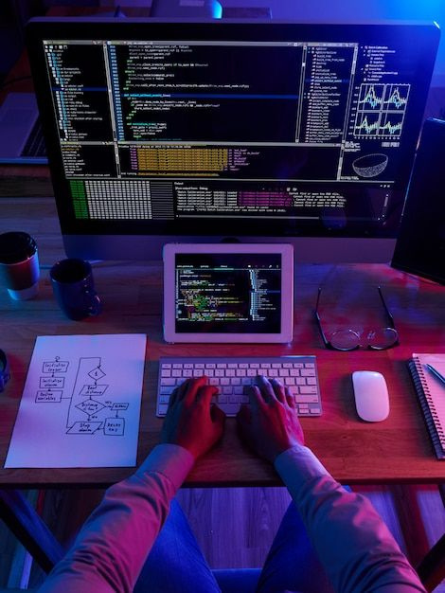
Languages ​​used
HTML
CSS
Three JS
Bootstrap
Other...

Slide 7

Future plans
Add new galaxies
Add new planets
Add new and different ideas

Slide 8


